Slide 1
Amazon Sales Analysis Project Report
Prajakta Bose

Slide 2
Introduction
Problem Statement:
The objective of this project is to perform a comprehensive analysis of Amazon sales data to identify trends, patterns, and insights that can inform business decisions and strategies.
Project Overview:
Dataset: The dataset consists of Amazon sales data spanning multiple years, including information about product categories, sales volumes, prices, and customer reviews.
Objectives:
Understand sales trends over time.
Identify top-performing product categories.
Analyze the impact of factors such as pricing and customer reviews on sales.
Extract actionable insights to optimize sales strategies.

Slide 3
Methodology
Data Preprocessing:
Cleaning: Addressed missing values, outliers, and inconsistencies in the dataset to ensure data integrity
Feature Engineering: Created new features or derived insights from existing ones to enhance analysis.
Exploratory Data Analysis (EDA):
Visualizations: Utilized various charts, graphs, and statistical summaries to explore data distributions, relationships, and trends.

Slide 4
Dataset Information
Region: Geographic region where the sales transaction occurred.
2. Country: Country where the sales transaction took place.
3. Item Type: Type of item sold in the transaction.
4. Sales Channel: Channel through which the sale was made, such as online or offline.
5. Order Priority: Priority level of the order, indicating its importance or urgency.
6. Order Date: Date when the order was placed.
7. Order ID: Unique identifier for each order.
8. Ship Date: Date when the order was shipped.
9. Units Sold: Number of units of the item sold in the transaction.
10. Unit Price: Price of each unit of the item.
11. Unit Cost: Cost of producing or acquiring each unit of the item.
12. Total Revenue: Total revenue generated from the sale, calculated as the unit price multiplied by the units sold.
13. Total Cost: Total cost incurred for producing or acquiring the units sold, calculated as the unit cost multiplied by the units sold.
14. Total Profit: Total profit generated from the sale, calculated as the difference between total revenue and total cost.

Slide 5
Data Analysis
Key Findings:
Sales Trends: Identified significant trends in sales volumes over time, highlighting peak seasons and periods of low activity.
Product Performance: Analyzed the performance of different product categories, identifying top-selling items and potential growth opportunities.
Factors Impacting Sales: Investigated the influence of pricing, customer ratings, and other factors on sales performance.
Insights:
Seasonal Variation: Sales tend to peak during the holiday season, suggesting opportunities for targeted marketing campaigns.
Product Recommendations: Certain product categories consistently outperform others, indicating potential areas for expansion or investment.
Price Sensitivity: Customer response to pricing changes varies across product categories, necessitating tailored pricing strategies.

Slide 6
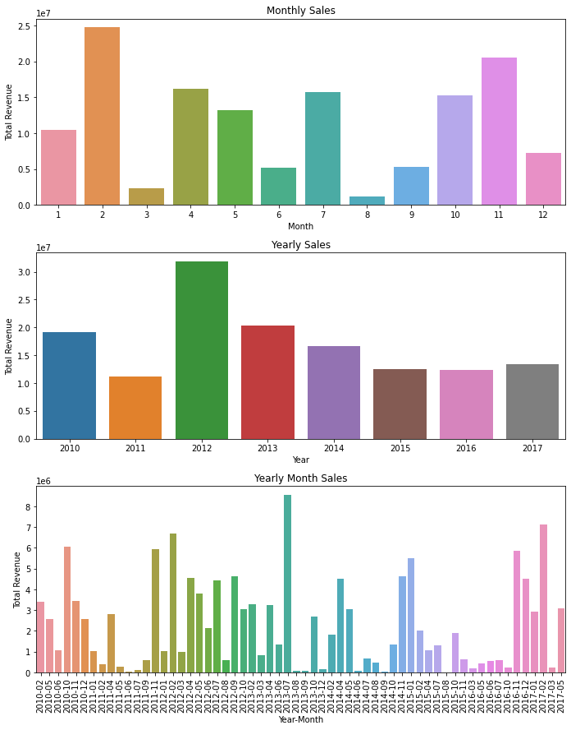
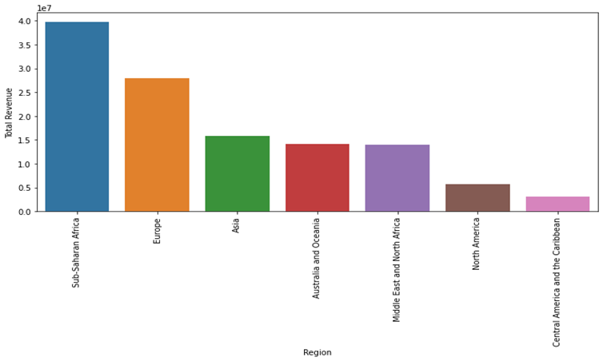
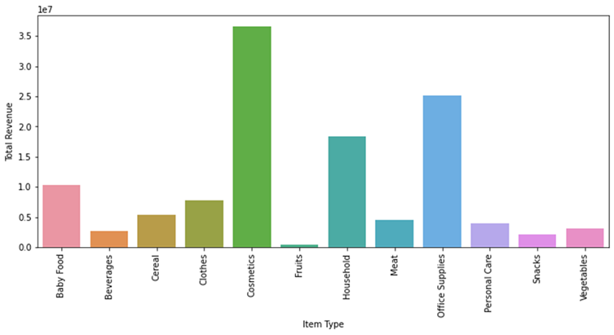
Key Visualizations
Sales performance over region
Sales Trend Analysis for monthly, yearly and yearly month
Sales by product category

Slide 7
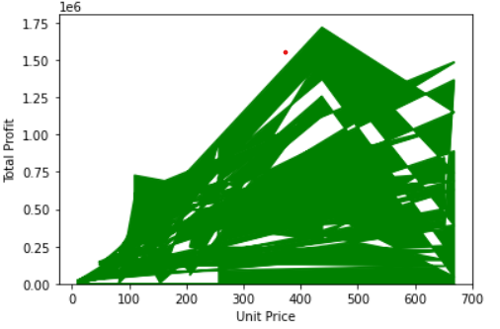
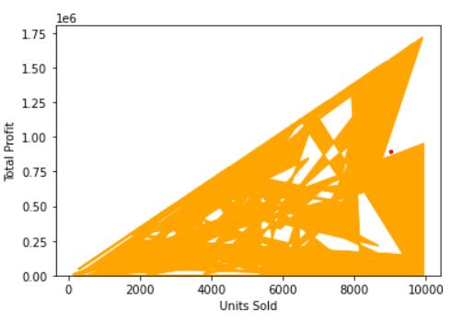
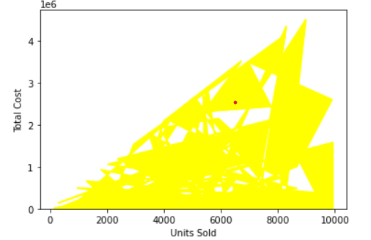
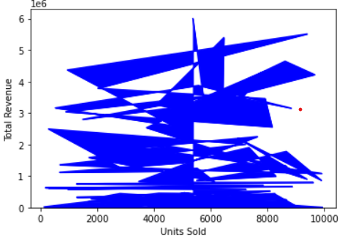
Key Visualizations
The maximum profit has been generated in the unit price range of ₹400-₹500.
Maximum profit has been generated when the number of units sold were between 8000 and 10000 i.e. more the number of units sold, more will be the profit generated.
Maximum cost has been generated when 8000-9000 units were sold.
Maximum revenue has been generated when products in the range 5000-6500 units were sold.

Slide 8
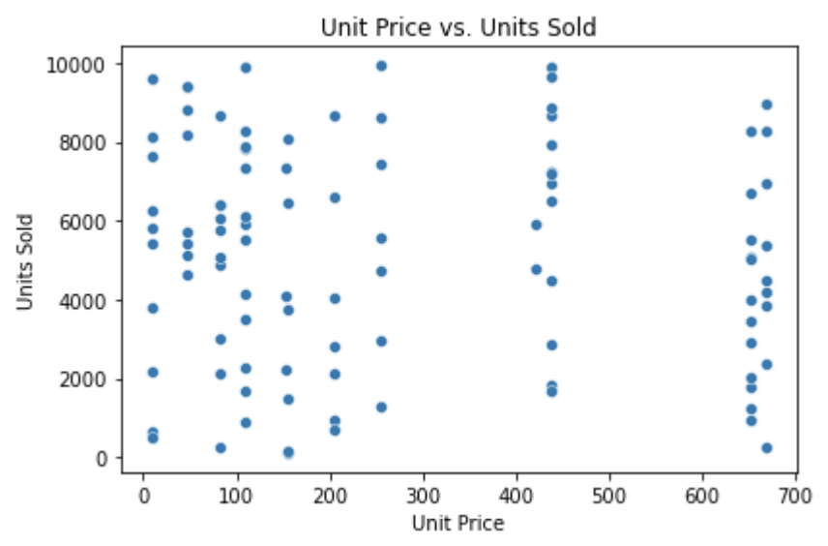
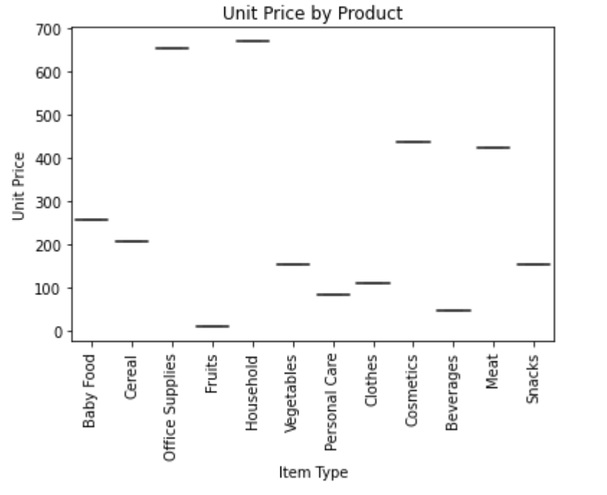
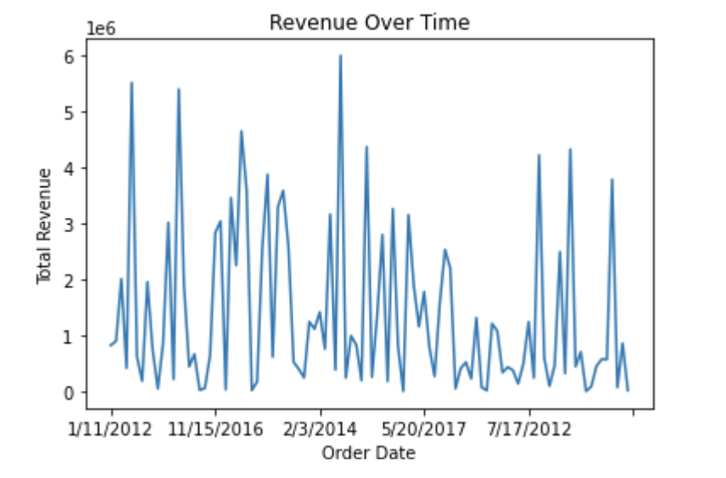
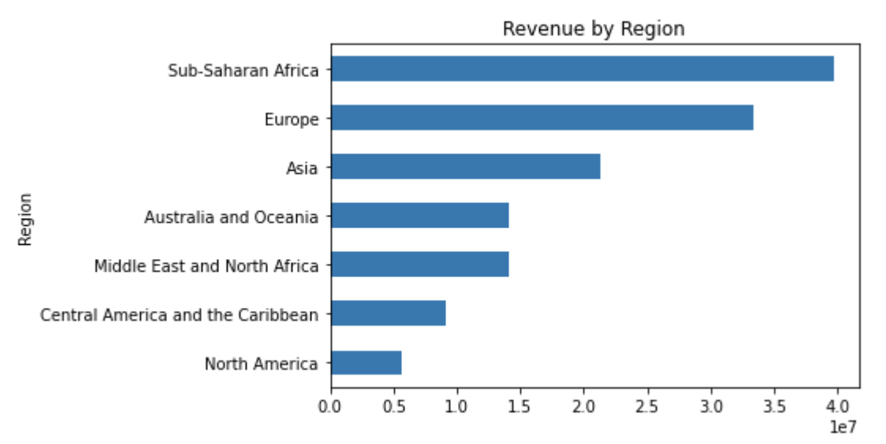
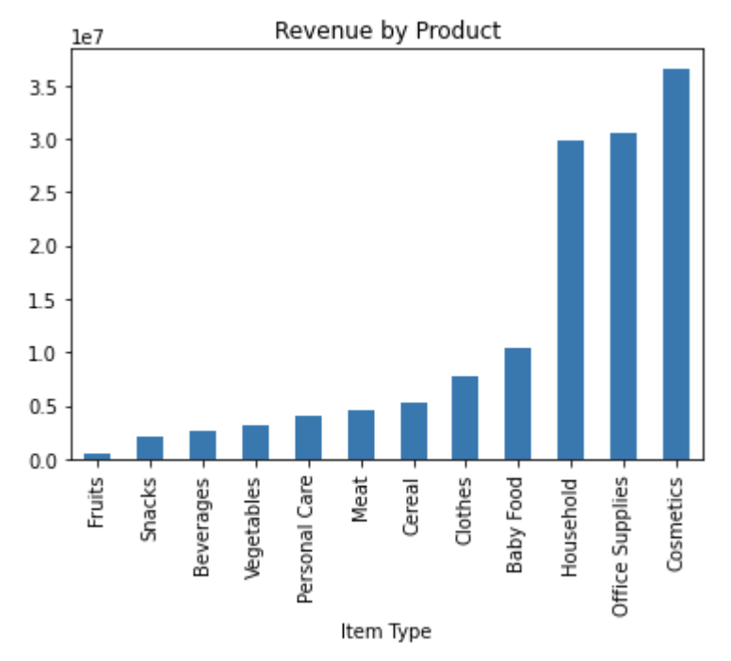
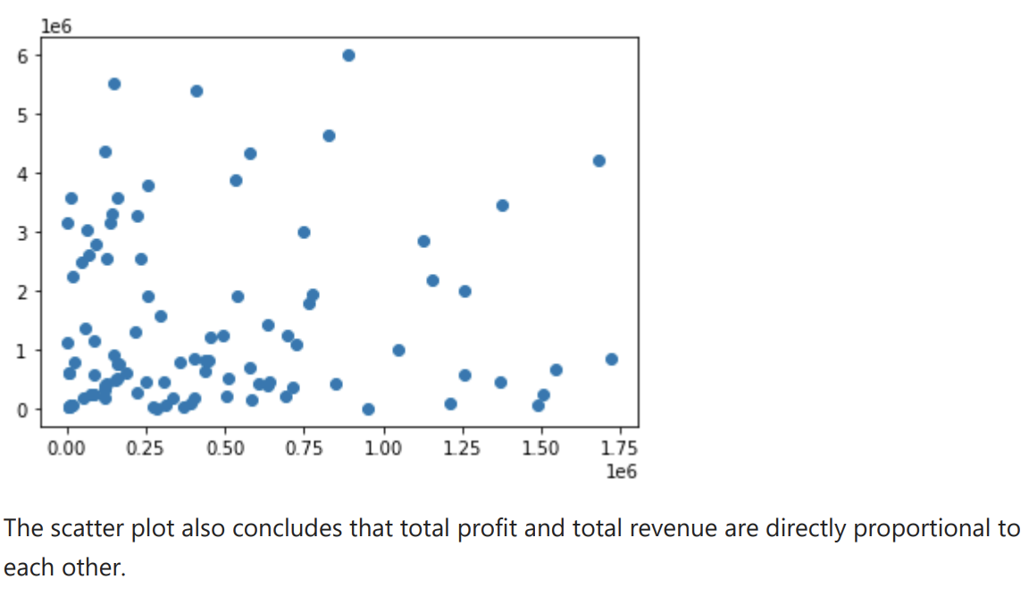
Key Visualizations

Slide 9
Conclusion
Summary of Findings:
The analysis reveals actionable insights into Amazon sales trends, product performance, and factors influencing sales.
These insights can inform strategic decision-making and optimization of sales strategies to drive business growth and maximize revenue.
Future Directions:
Further analysis could explore predictive modeling to forecast future sales trends and optimize inventory management and pricing strategies.

